Slide 1
Technical Deep Dive Migrating Applications to Microsoft Azure – Day 2
<Presenter Name>

Slide 2

Agenda & Recap
Contoso Application Challenges
Cloud Computing Execution Models
Migrating On-Premises Application to:
Virtual Machines
Cloud Services
App Services
Migrating Application Database:
Azure SQL Database
SQL Server in IaaS
Migrate the Authentication mechanism to Azure Active Directory
Partner Audience: Developer, Architects, IT Pros

Slide 3
Database Migration

Slide 4
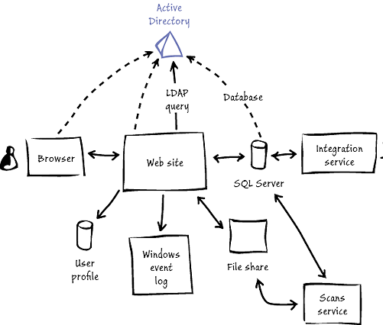
Our Scenario for Today – Migrate App Database to Azure
Contoso Challenges
Contoso faces several challenges. Currently, deploying new on-premises applications takes too long, considering how quickly its business changes and how efficient its competitors are. The timeframe for acquiring, provisioning, and deploying even a simple application can be at least several weeks. No matter the application's complexity, requirements must be analyzed, procurement processes must be initiated, requests for proposals may need to be sent to vendors, networks must be configured, and so on. Contoso must be able to respond to its customers' demands more rapidly than the current procedures allow.

Slide 5
Relational Data Services on Azure
SQL Server in a Virtual Machine
(IaaS)
Azure
SQL Database
(DBaaS)
DB
Full Control & Flexibility
Near-zero Administration
Migrate Existing Apps
Dev. & Test
Backup to the Cloud
Disaster Recovery
Migrate
On-Premises Web Apps
Cloud-designed Business Apps
Build Software-as-a-Service Apps
Highly Customized Environment
Fast Time-to-Cloud for Existing Apps
Eliminate Hardware Costs
Fully Managed Service
Dramatically increase DB:IT ratio
Eliminate CAPEX & Reduce OPEX

Slide 6

SQL Migration Decision Point
Migrate to SQL Azure (PaaS)
Database-as-a-Service
Lower cost than IaaS
Shared environment
Limited SQL Server features
Databases of up 1 TB in size
Sold as a service
Total cost of application = Highly minimized administration costs + software development costs + Azure SQL Database service costs
Migrate to SQL Server in Azure (IaaS)
Infrastructure-as-a-Service
Full administrative rights & resp.
Dedicated SQL Server instance
All SQL Server features
Databases > 1 TB in size
SQL Server in Azure VM requires traditional SQL Server licensing
Total cost of application = Minimized software development/modification costs + administration costs + SQL Server & Windows Server licensing costs + Azure Storage costs
Link

Slide 7
Migrating to Microsoft Azure – IaaS
Right-Sizing the VMs
Cost impact – will pay compute, storage and bandwidth charges
Data Import and Export service for large data sets:
http://www.windowsazure.com/en-us/documentation/articles/storage-import-export-service
Supported Versions
Bring your own – 2008, 2008 R2, 2012, 2014
Platform – 2008 R2, 2012, 2014
Licensing Considerations
BYO – License Mobility via Software Assurance
Platform – Included in the per hour rate
More at http://msdn.microsoft.com/library/windowsazure/dn133142.aspx

Slide 8
SQL Server Microsoft Azure Integration
SQL Server 2012
Backup to Microsoft Azure blob storage (PowerShell or T-SQL), On-premises and Microsoft Azure
SQL Server 2014
Database Migration to Microsoft Azure
SQL Server Always On Hybrid (On-Premises and Replica in Microsoft Azure)
SQL Database files can be created directly in Microsoft Azure Storage
SQL Server Backup to Microsoft Azure Storage URL or fully Managed with UI Integration

Slide 9
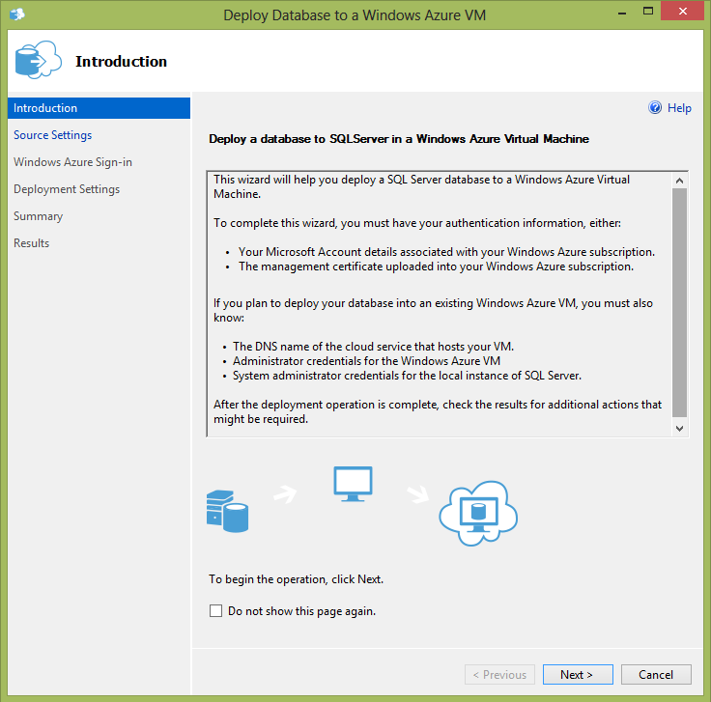

SQL Server Management Studio (SSMS) for migration to Azure VMs
What’s delivered
New wizard to deploy databases to SQL Server in a Microsoft Azure VM
Can also create a new Microsoft Azure VM if needed
Main benefits
Easy to use
Perfect for database administrators new to Microsoft Azure and for ad hoc scenarios
Complexity is hidden
Detailed Microsoft Azure knowledge is not needed.
Very low overhead: Database size is the defining factor for time-to-transfer

Slide 10
Azure SQL Database - Service Tiers
Predictable performance and business continuity
Basic
Small database
Single operation at one point in time
Up to 2GB DB Size
Standard
Typical workgroup or web application
Multiple concurrent transactions
Up to 250 GB DB Size
Premium
Mission-critical applications
High volume of concurrent transactions
Up to 1000 GB DB Size
Web and Business tiers are being retired

Slide 11
PaaS - Predictable Performance
Service Tier | Performance Level | DTUs | Maximum Sessions | Predictability
Basic | Basic | 5 | 300 | Good
Standard | S0, | 10 | 600 | Better
 | S2 | 20 | 900
 | S1 | 50 | 1200
 | S3 | 100 | 2400
Premium | P1 | 125 | 2400 | Best
 | P2 | 250 | 4800
 | P4 | 500 | 9600
 | P6/P3 | 1000 | 19200
 | P11 | 1750 | 32000
 | P15 | 4000 | 32000

Slide 12
PaaS - Predictable Business Continuity
Service Tier | Performance Level | Point in Time Restore | Disaster Recovery
Basic | Basic | From the past 7 days | Active Geo-Replication
Standard | S0 | From the past 35 days | Active Geo-Replication
 | S1
 | S2
 | S3
Premium | P1 | From the past 35 days | Active Geo-Replication
 | P2
 | P4
 | P6/P3
 | P11
 | P15

Slide 13
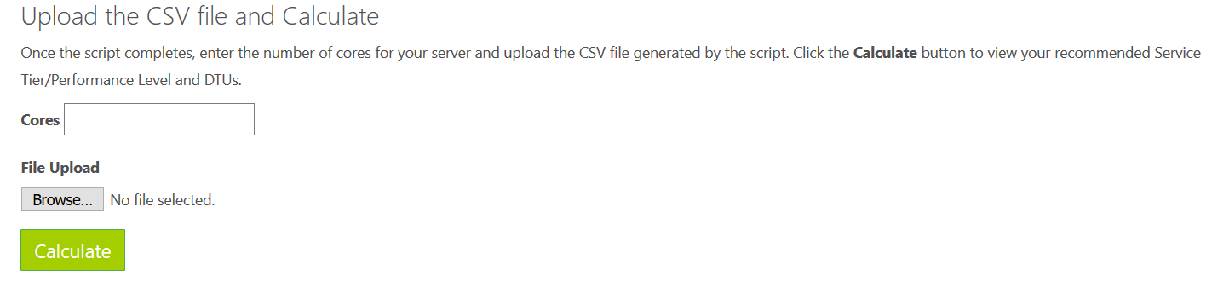
Azure SQL Database DTU Calculator
Azure SQL Database
Measure resource utilization
Processor - % Processor Time
Logical Disk - Disk Reads/sec
Logical Disk - Disk Writes/sec
Database - Log Bytes Flushed/sec
To help our customers and partners, we have a site which help us to calculate the DTU:

Slide 14
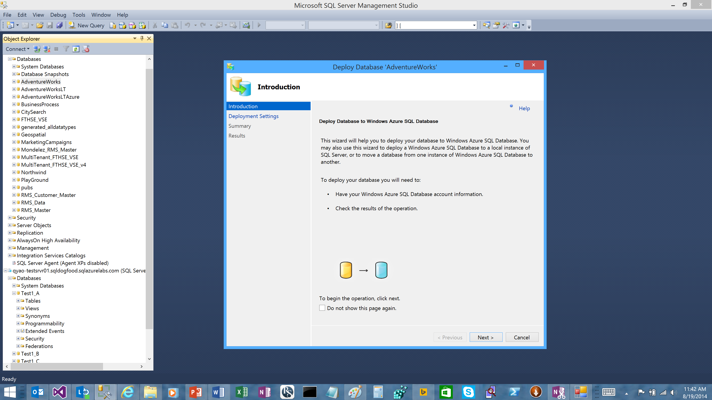
SQL Server Management Studio (SSMS) for migration to SQL Database
Overview
Familiar database development and management environment
Generate scripts targeted at Microsoft Azure SQL Database Service
Export data-tier application
Extract data-tier application
Deploy database to Microsoft Azure SQL Database Service
Limited assessment scope

Slide 15
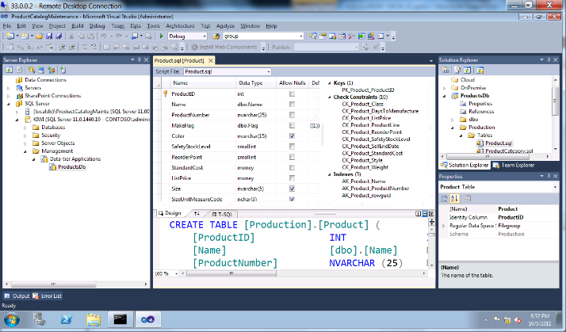
SQL Server Data Tools (SSDT) for migration to VMs and SQL Database
Overview
Visual Studio Integrated Development Environment (IDE) for database development
Includes modern designers and projects with declarative, model-driven development
Develop and test in both connected and disconnected states
Platform targeting for both SQL Server (2005 and above) and Microsoft Azure SQL Database Service
Get SSDT free with Web Platform Installer, with SQL Server, and with Visual Studio

Slide 16
Azure SQL Database Migration Wizard (SQLAzureMW)
Overview
Helps you migrate your SQL Server 2005/2008/2012/2014 databases to Microsoft Azure SQL Database Service
User interactive wizard that walks you through the analysis and migration process
Able to analyze SQL Profiler Trace files to check Dynamic SQL for compatibility issues
Generates clustered indexes for review and modification
Provides customizable rules engine to help identify patterns within T-SQL.
Has two command-line utilities:
SQLAzureMWBatchBackup
SQLAzureMWBatchUpload

Slide 17
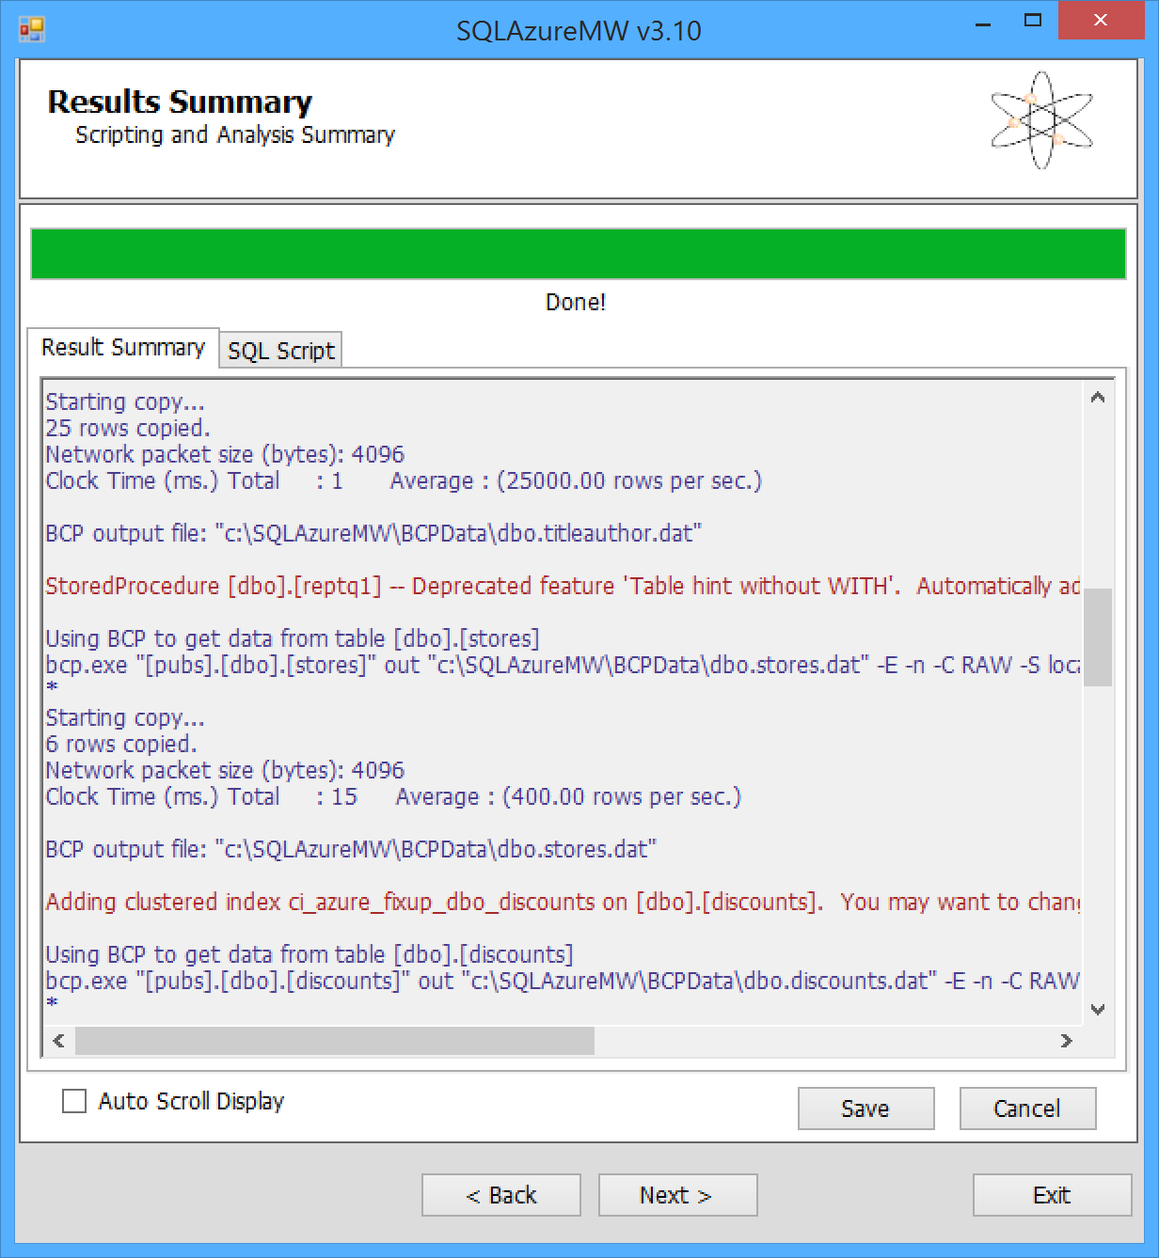
SQL Database Migration Wizard
Continued
Offers options to analyzes, generate scripts, and migrate data—via Bulk Copy Process (BCP)—from:
SQL Server to Microsoft Azure SQL Database Service
Microsoft Azure SQL Database Service to SQL Server
Microsoft Azure SQL Database Service to Microsoft Azure SQL Database
Uses SQL Server Management Objects (SMO) for scripting
Uses BCP for data loading process
Uses Regex for pattern matching
Choose objects (views, tables, stored procedures, etc.) to migrate

Slide 18
Migrate Database to
IaaS – SQL Server Virtual Machine
PaaS – Azure SQL Database

Slide 19
Migrate the Authentication Mechanism to Azure Active Directory

Slide 20
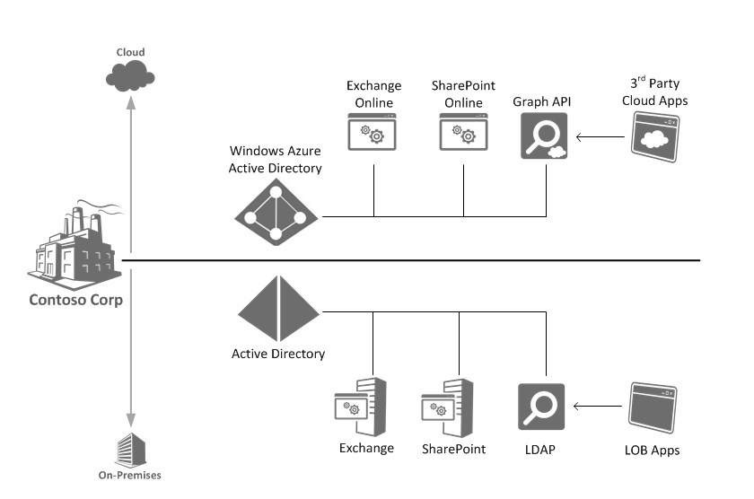
Similarities between Active Directory & Microsoft Azure Active Directory

Slide 21
Application Access Overview
Software-as-a-Service (SaaS) Applications
Organizations increasingly rely on SaaS applications to support business activities.
Microsoft Azure AD enables easy integration to many of today’s popular SaaS applications, such as Salesforce, Box, Google Apps, DocuSign, DropBox. etc.
Tenets of Integrating SaaS Apps w/Microsoft Azure AD
Single Sign-On (SSO) enables users to access their applications using their organizational ID.
Account synchronization enables user provisioning/de-provisioning into application based on changes in Windows Server AD and/or Microsoft Azure AD.
Centralized application access management.
21

Slide 22
Access Panel
http://myapps.microsoft.com
This is where users can discover the applications they have access to.
Features of the Access Panel
Users can change the password associated with their organizational account.
Users can edit multi-factor authentication-related contact and preference settings.
Users can view details about their account.

Slide 23
Implement Azure Active Directory in the Application

Slide 24

Summary

Slide 25
Summary
IaaS provides more flexibility. However, with PaaS your team will have less things to manage.
IaaS enables an easier migration process.
IaaS is easier for measuring costs, leverage starter kits.

Slide 26
Additional Resources

Slide 27
Azure Execution Models - Resources
Virtual Machines (link)
App Services (link)
Cloud Services (link)
What Should I Use? Making a Choice (link)

Slide 28
Q & A

Slide 29
Contact Us Technical services to help you win more deals, accelerate deployment and increase consumption
Microsoft Azure
http://aka.ms/PartnerTechnicalServicesAzure
Microsoft CRM Online
http://aka.ms/PartnerTechnicalServicesCRMOnline
Microsoft Office 365
http://aka.ms/PartnerTechnicalServicesO365
Microsoft Windows 10 and Enterprise Mobility Suite
http://aka.ms/PartnerTechnicalServicesWin10EMS
Learn more about your technical support benefits
http://aka.ms/MySupport

Slide 30
Thank You! Gracias! Obrigado!

Slide 31
Appendix

Slide 32
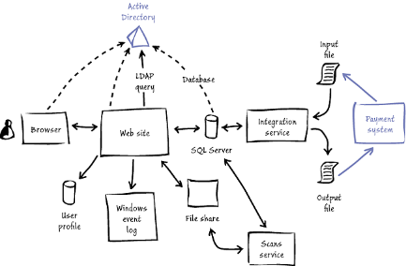
Comparing Prices - Application
Infrastructure Prices
 | Virtual Machines | Cloud Service | Web Site
Bandwidth / Bandwidth – 1TB | U$ 87 | U$ 87 | U$ 87
Web Sites – 2 Instances Avg 7GB RAM / 4 Cores | U$ 535.68 A Series – A4 | U$ 476.16 A Series – A4 | U$ 223.20 Basic
Active Directory | U$ 66.96 A Series – A1 | U$ 0 Azure AAD | U$ 0 Azure AAD
Licensing | U$ 0 | U$ 0 | U$ 0
Hybrid Connectivity | U$ 26 | U$ 26 | U$ 0
Storage – 200 GB | U$ 10 | U$ 10 | U$ 10
Total / Month | U$ 725.64 | U$ 599.16 | U$ 320.2
Administrative Cost
Migration Time | 20 Hours | 80 Hours | 100 Hours
Migration Cost | U$ 2000 | U$ 8000 | U$ 10000
Maintenance Effort / Cost | 10H/U$1000 (Month) | 5H/U$500 (Month) | 5H/U$500 (Month)
3 Years Estimation – 36 Months | U$ 64123.04 | U$ 47569.76 | U$ 39527.2

Slide 33

Comparing Prices – Relational Database
Infrastructure Prices – SQL Enterprise or License Needed (SCENARIO 1)
 | SQL in Virtual Machines | Azure SQL Database
Database – 2 Instances Avg 7GB RAM / 4 Cores | $2,767.68 (Enterprise) | U$ 930 (Premium P1)
Storage – 1024 GB | $50 | U$ 0
Total / Month | U$ 2817.68 | U$ 930
Infrastructure Prices –License Mobility (SCENARIO 2)
 | SQL in Virtual Machines | Azure SQL Database
Database – 2 Instances Avg 7GB RAM / 4 Cores | $535.68 | U$ 930 (Premium P1)
Storage – 1024 GB | $50 | U$ 0
Total / Month | U$ 585.68 | U$ 930
Administrative Cost
Migration Time | 20 Hours | 160 Hours
Migration Cost | U$ 2000 | U$ 16.000
Maintenance Effort / Cost | Medium / U$ 1000 (Month) | Lower / U$ 500 (Month)
3 Years Estimation – 36 Months (SCENARIO 1) | U$ 139436.48 | U$ 67480
3 Years Estimation – 36 Months (SCENARIO 2) | U$ 59084.48 | U$ 67480

